Slide 1

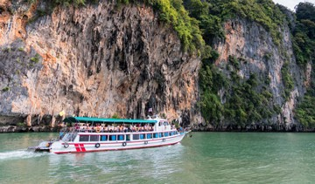
Travel Website

Slide 2
ABOUT
Travelicious… a destination for all those who love to travel.
Here we provide information on what to do and where to stay for and help you to choose your travel destinations. This is a perfect place to find new deals.
We offer a booking scheme form so that users can login into the page and fill in the form which have fields such as source, destination, departure and arrival (time).

Slide 3
If the user has no account , then he can sign up and create one.
In the website we have given descriptions of some hotels for a comfortable stay. The website also covers some tour packages which contains the number of days of stay , places being covered and price per person and finally we have a gallery which displays pictures.

Slide 4
Website that is hosted on
http://keerthipriya.pythonanywhere.com/

Slide 5
Individual contribution of each team member
Keerthi created the front end and UI and forms part including bootstrap.
Aishwarya did the back end part to create login and signup pages.
Tanusha worked on editing and creating certain pages for the website.

Slide 6
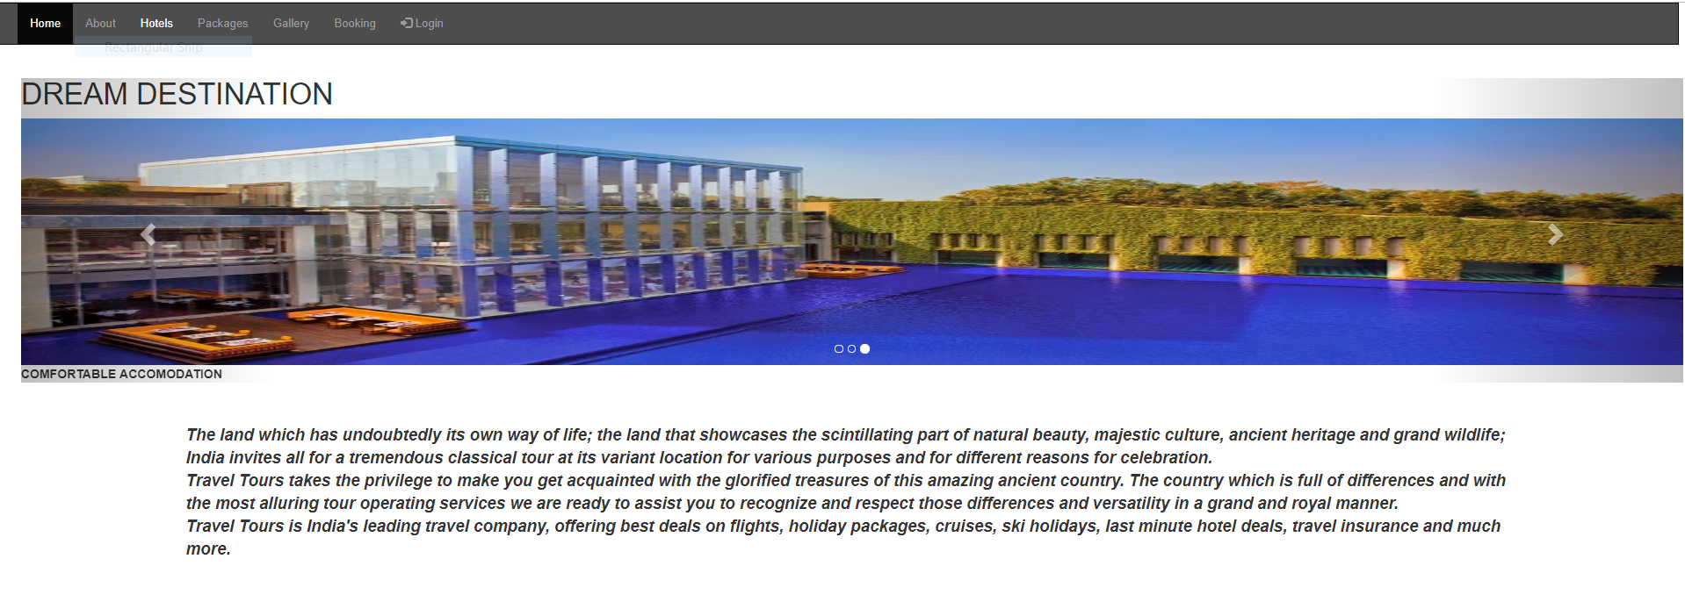
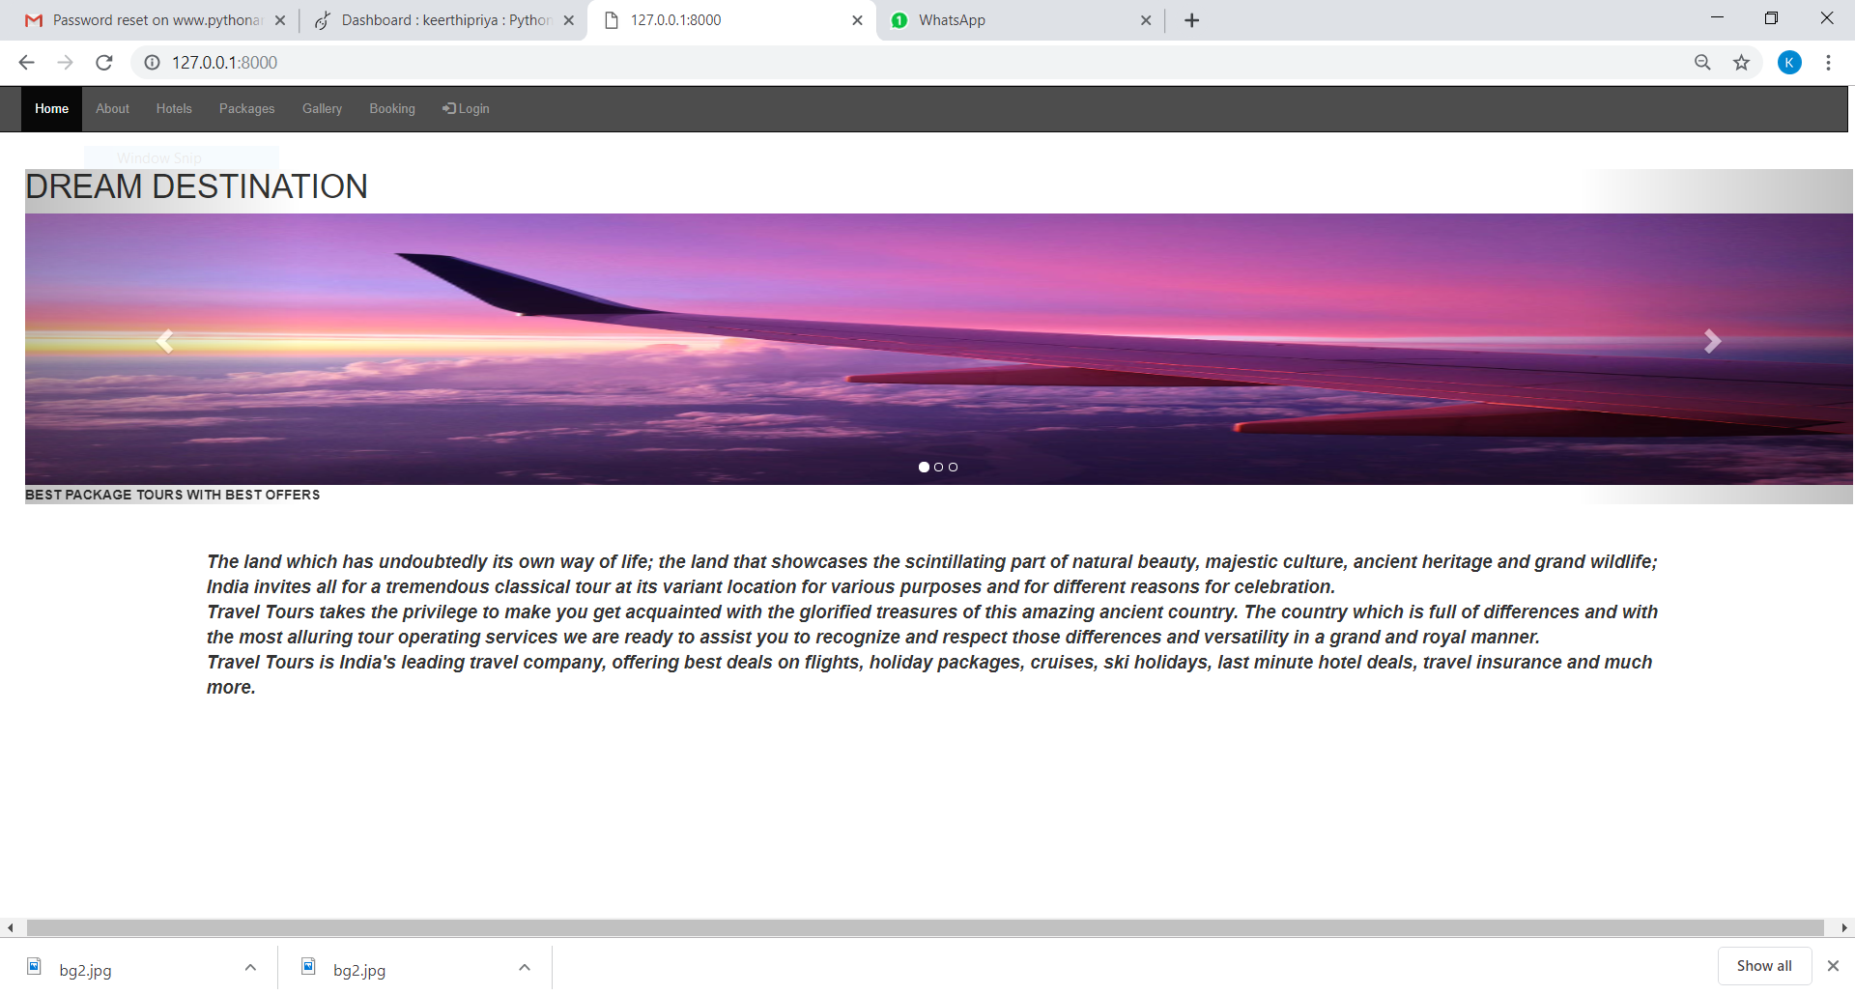
SCREEN SHOTS

Slide 7
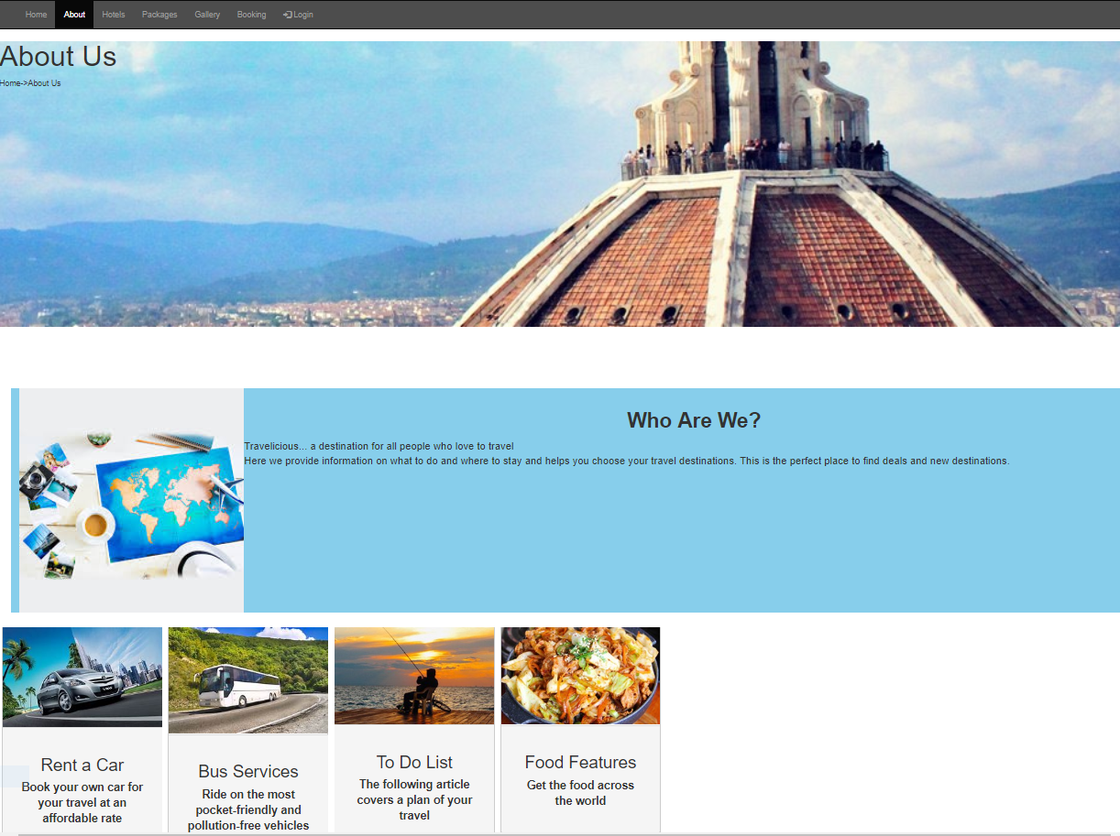
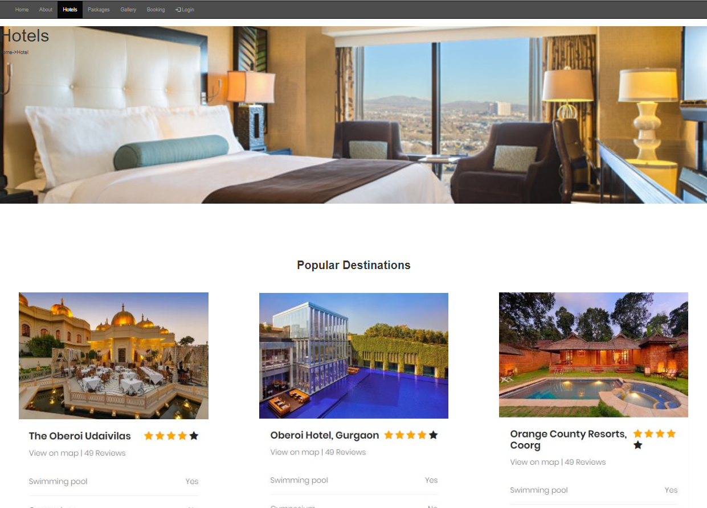

Slide 8
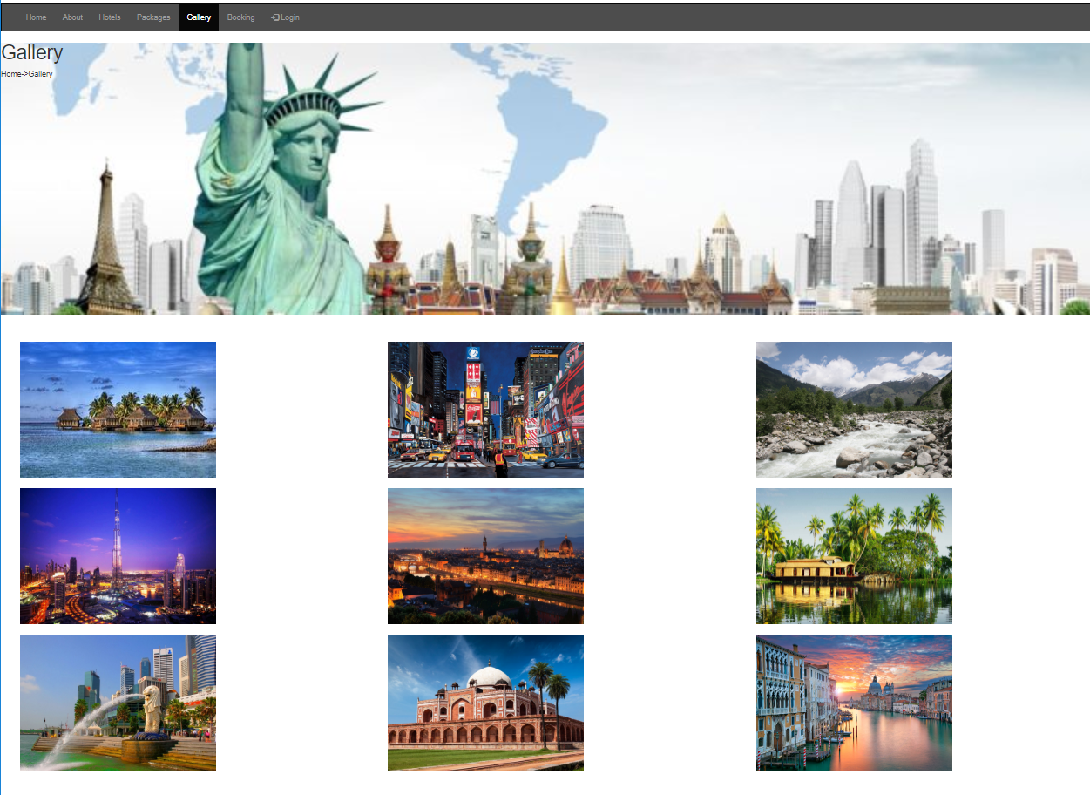
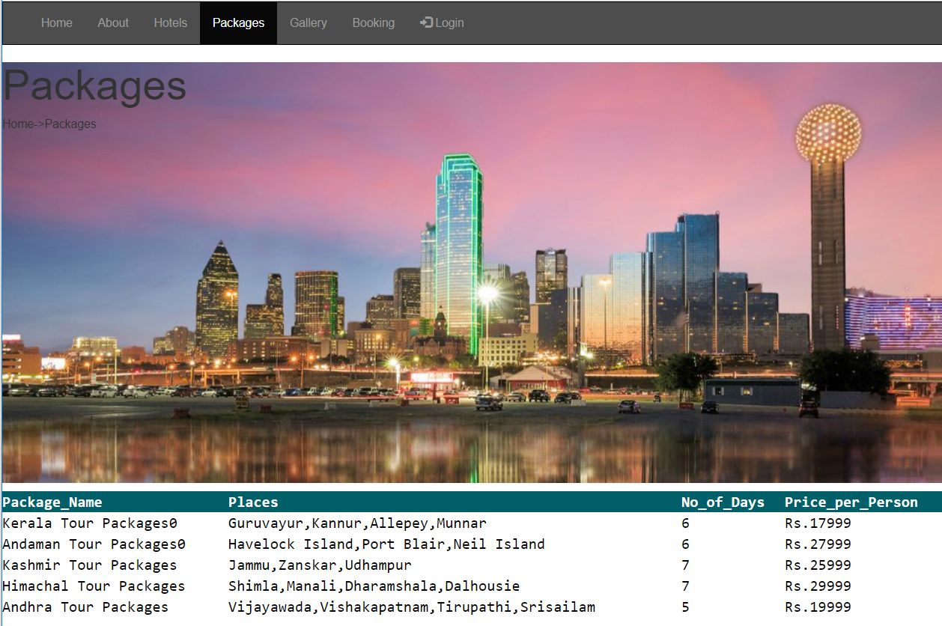

Slide 9
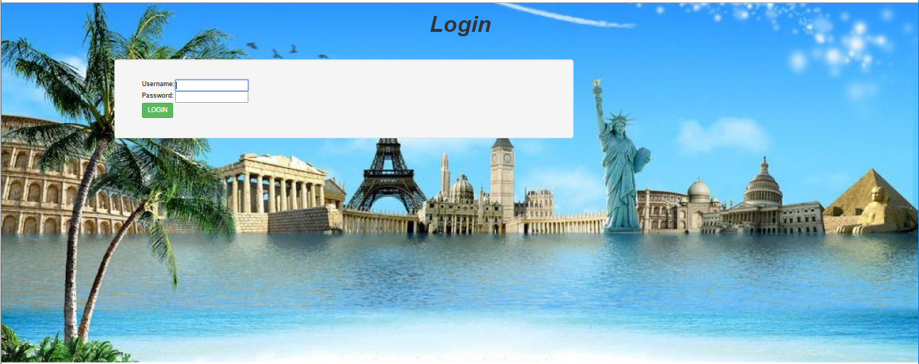
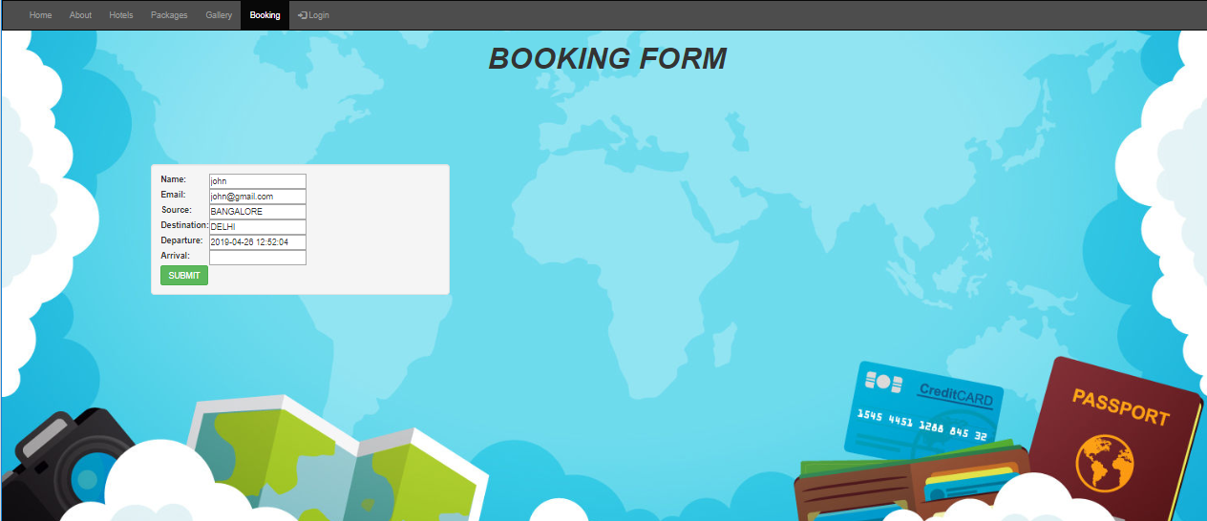

Slide 10
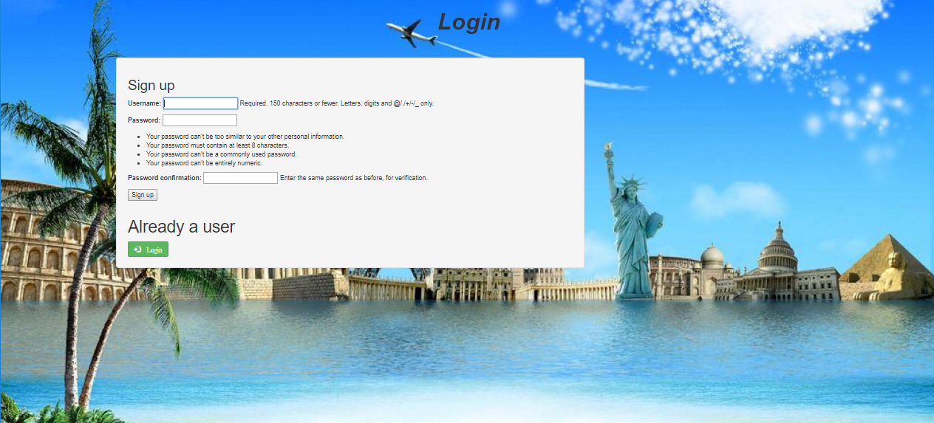

Slide 11
TAKEAWAYS
From this project of the web frameworks we have successfully created a website based on travel and tourism using the concepts of Django used in class.
We are able to implement these features along with the UI to create a appropriate pages using the concepts of Web technology we had learnt earlier. Django proved to be a really fast and powerful tool for building web applications.
The ability of Django’s ORM to extract information speeds up web application development and helps developers build working prototypes in no time. Developers don’t necessarily have to know the language used for database communication to manipulate data.

Slide 12
CHALLENGES
Local Environment Setup
One of the biggest initial hurdles that new users face is configuring their local environment for Django. It takes longer to install the framework locally than to build their first app.
Projects versus Apps
As a beginner to Django (or MVC frameworks in general), the terms "projects" and "apps" were a little confusing.
Template Inheritance
Template inheritance is one of the best features of Django, but it usually takes a while to truly understand.
Migrations
This happens when you already have fields in your database (production or development), and you add something that modifies the database.

Slide 13
TEAM MEMBERS
Aishwarya Pramod
Keerthi Priya P
Thanusha Sai Melavoy
PES1201700770
PES1201701643
PES1201701457
aishwarya.1999@gmail.com
keerthipp1999@gmail.com
thanushamelavoy@gmail.com

Slide 14
THANK YOU

